Slide 1
Google Solution Challenge 2025
Problem Statement ID –1624
Problem Statement Title- "To Develop An Artificial Intelligence (AI) Based Model For Electricity Demand Projection Including Peak Demand Projection For Delhi Power System”
Theme-AI For Sustainable Development
PS Category- Software
Team Name- Bold Victory Squad

Slide 2
Proposed Solution
Data Collection: Collecting Historical Data Of Electricity Demand In Delhi Including Data Like Weather ,Public Holidays, Weekly Holidays Etc.
Data Preprocessing: Clean The Data By Addressing Missing Values And Inconsistencies. Normalize And Scale The Data To Ensure Compatibility With Machine Learning Models.
Compensation Methodology: Fine-tuning The Model's Predictions To Be More Accurate By Adjusting Factors For Weather, Solar Power Etc.
Model Development: Selecting Suitable Model Such As LSTM Networks To Feed Data And Train Models And Evaluating Models Performance.
Model Optimization: Cross Verify To Ensure The Model Works Fine And Generalizes Well To Unseen Data And Optimize Using Certain Techniques.
Deployment : Deploy The Trained Model On A Cloud Platform (E.G., AWS, Azure) For Real Time Testing And Set Up API For Easy Integration With Existing Systems And Implementing Data Continuously To Keep Model Updated.
User Interface And Visualization : Develop A Dashboard For Visualizing Forecasts , Predictions , And Adding Features Like Alert Notification During Unexpected Circumstances.
Monitoring And Maintenance: Monitoring Model Performance Using Required Tools And Regular Update For Model Helps To Track Data Seamlessly .

Slide 3
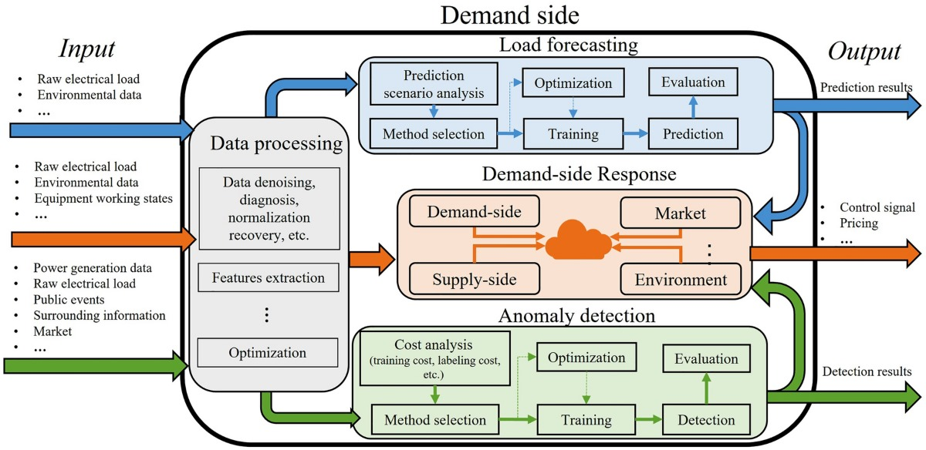

Slide 4


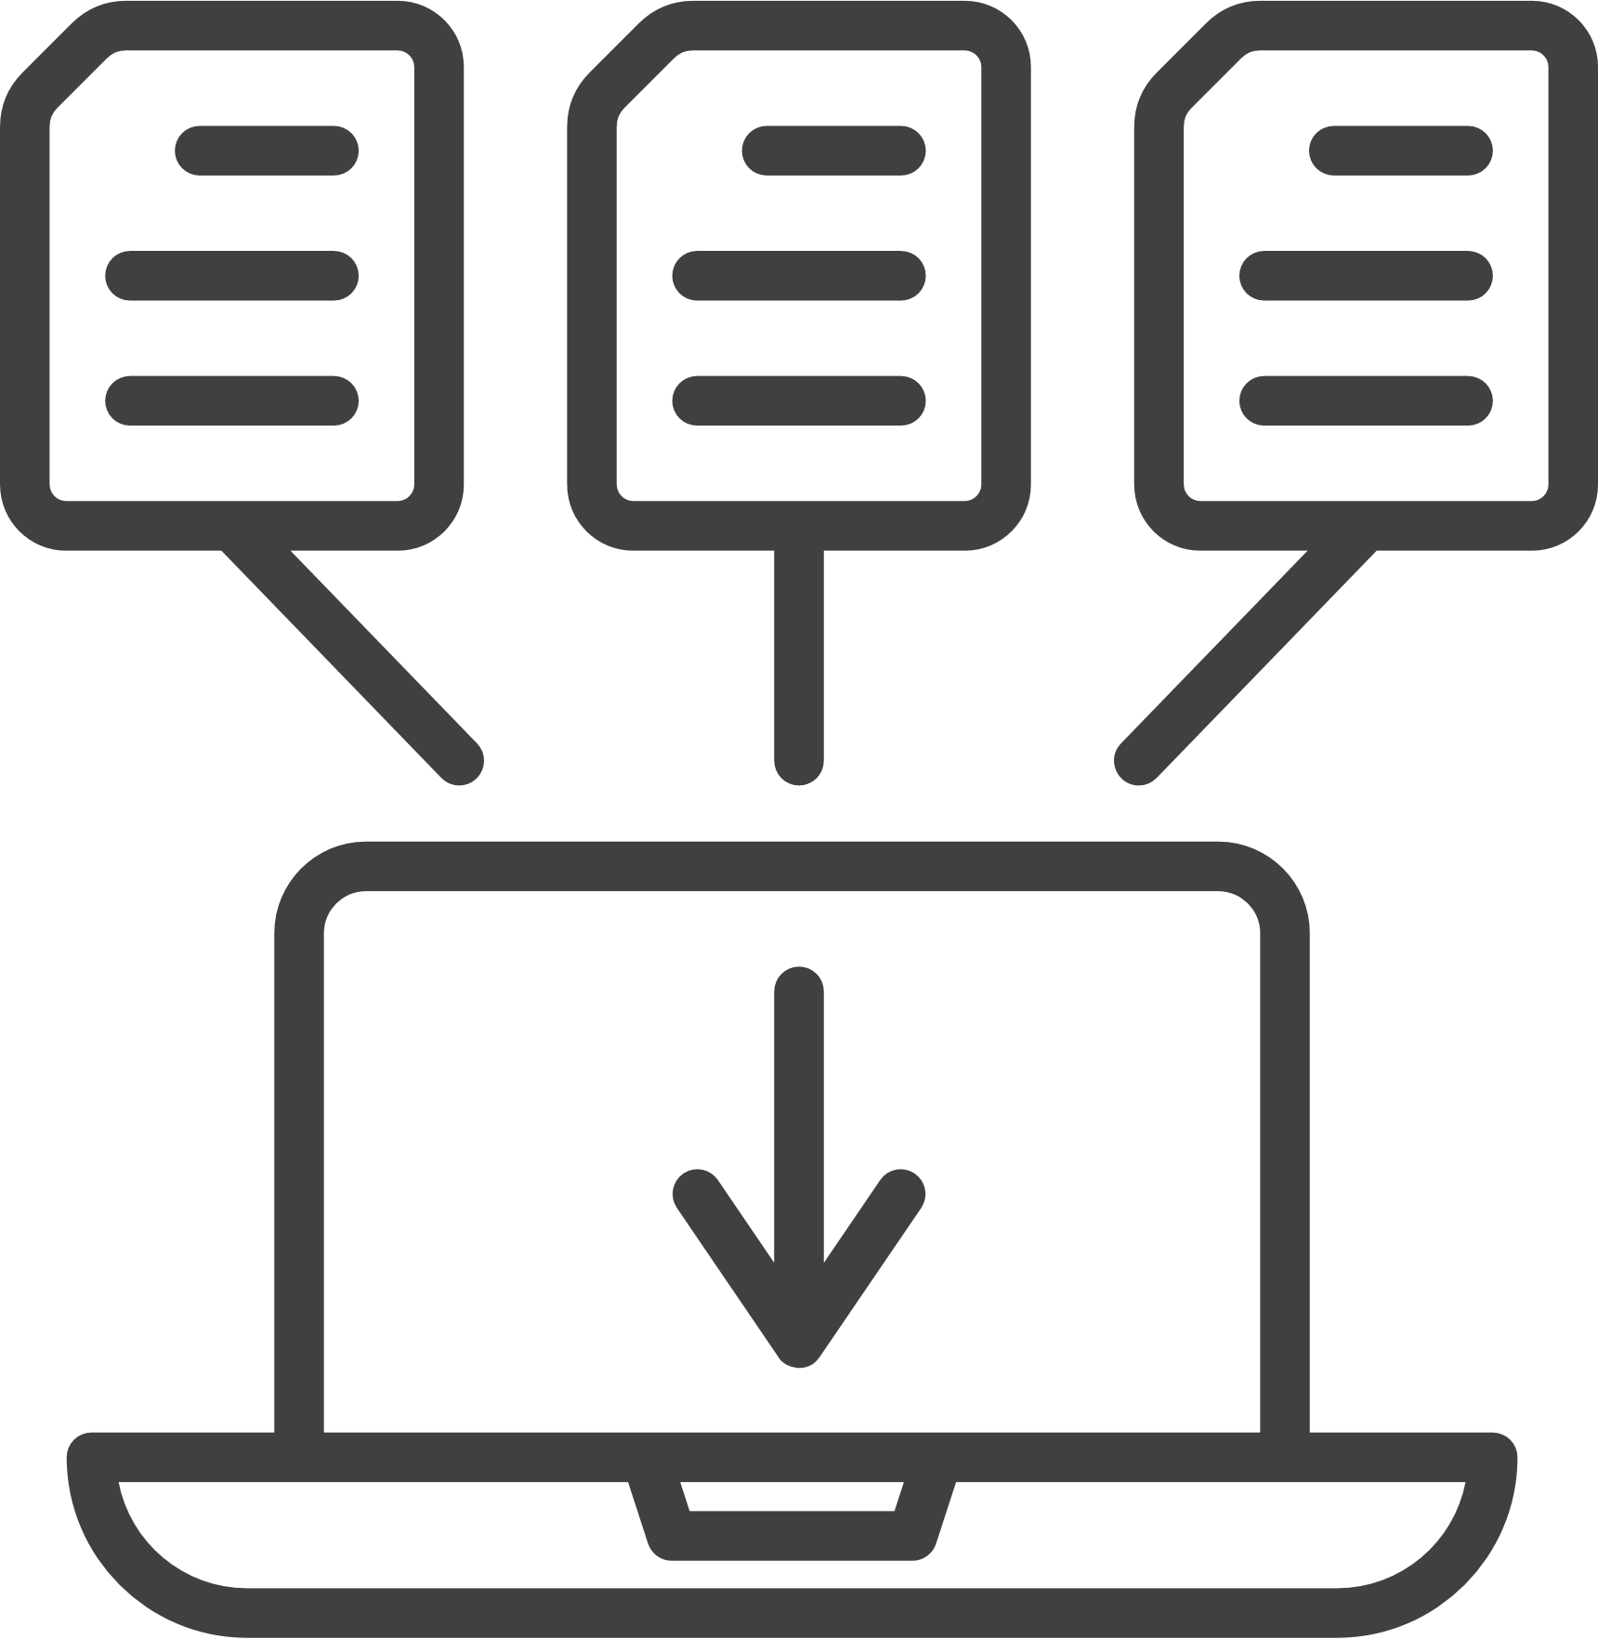




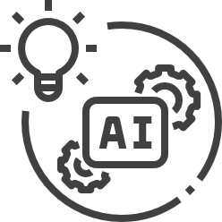
Work Flow
Collect Data
Data Like Weather ,Holiday
Historical Electricity Usage.
Process Data
Clean ,Review , Aggregate,
Normalize And Scale Data.
Compensation Methodology
Adjust For Weather Effects
Factors For Holidays And
Tuning Prediction .
Select AI Model
Use LSTM Or Any Other
Model Like Forest Etc.
Time Series Or Regression.
Train Model
Good Performance?
Bad Performance?
Deploy And Integrate Real Time Data
And Update Regularly.
Check Performance
Refine And Deploy Again.

Slide 5



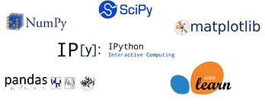



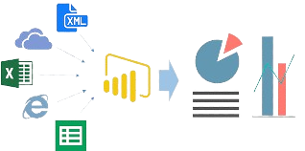







Feasibility And Viability
Technology Stack
Data Collection:
Inconsistent Or Missing Data.
Difficulty In Integrating Diverse Data Sources.
Real-time Processing:
Ensuring Low-latency Data Processing And Prediction.
Handling High Data Volume And Velocity.
Impact And Benefits
Accurate And Reliable Electricity Demand Projections
Improved Planning And Decision-making For Power Infrastructure
Optimized Resource Allocation And Investment Strategies
Enhanced Resilience And Adaptability To Changing Demand Patterns
Reduced Energy Costs And Environmental Impact

Slide 6
Research And References
Zia Fatima, Saleem Khan, "Artificial Intelligence for Smart Grid Forecasting and Analytics: The State-of-the-Art, Challenges, and Future Trends“, IEEE Access, 2020.
Md. E. Hossain, K. M. Salim, et al, "Short-Term Load Forecasting Using Deep Learning Techniques: A Review“, Energy Reports ,2022.
Rahul Sharma, P. K. Singh ,"AI-Based Electricity Demand Forecasting Using Hybrid Models“, Energy Informatics,2019.
Hamidreza Salehinejad , Seyed R. Eslami , et al ,"Deep Learning for Load Forecasting: Trends, Challenges, and Future Directions“ , IEEE Transactions on Smart Grid ,2021.
M. E. El-Hawary ,"Artificial Intelligence Applications in Electrical Power Systems“,Wiley-IEEE Press, 2009.
J. Z. Huang, S. C. Chou , "Data Analytics for Renewable Energy Integration: Forecasting, Modeling, and Optimization ,Springer ,2018.
External Links:-
https://www.delhisldc.org/ (State Load Dispatch)
https://huggingface.co/datasets (ViT)(huggingface.co)
https://link.springer.com/article/10.1007/s40684-023-00537-0
https://www.iea.org/data-and-statistics/data-product/world-energy-outlook-2023-free-dataset-2
https://arxiv.org/ ([2303.12799] Time Series as Images: Vision Transformer for Irregularly Sampled Time Series)
https://arxiv.org/ [2010.11929] An Image is Worth 16x16 Words: Transformers for Image Recognition at Scale)
https://www.sciencedirect.com/science/article/pii/S092041051930600X
https://github.com/google-research/vision_transformer

